Slide 1
OUTLINE
Card Detection
Attempts and Research
Method
Dataset Preparation
Data Augmentation
Training
Strategy
Results
Chip Detection
SPECIAL PROJECT

Slide 2
Attempts
Denoising
Color space Conversion
Edge Detection with Various Filters
Closing, Opening
Research
Deep Learning Architecture
YOLO
Quick Inference
Framework
Darknet
Easy to Train

Slide 3
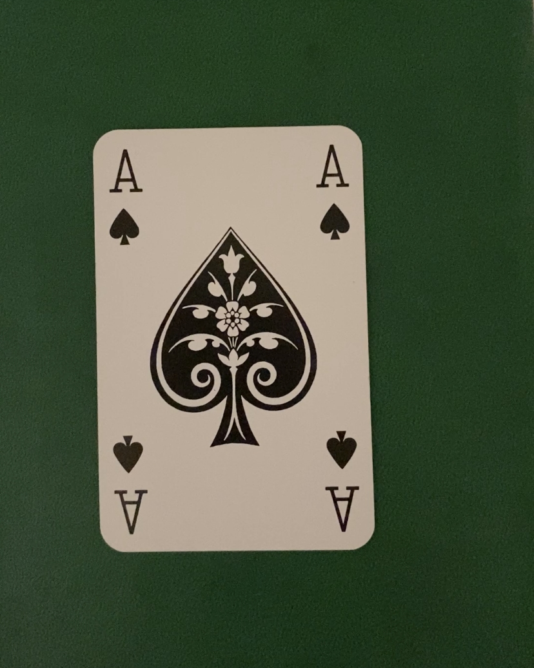
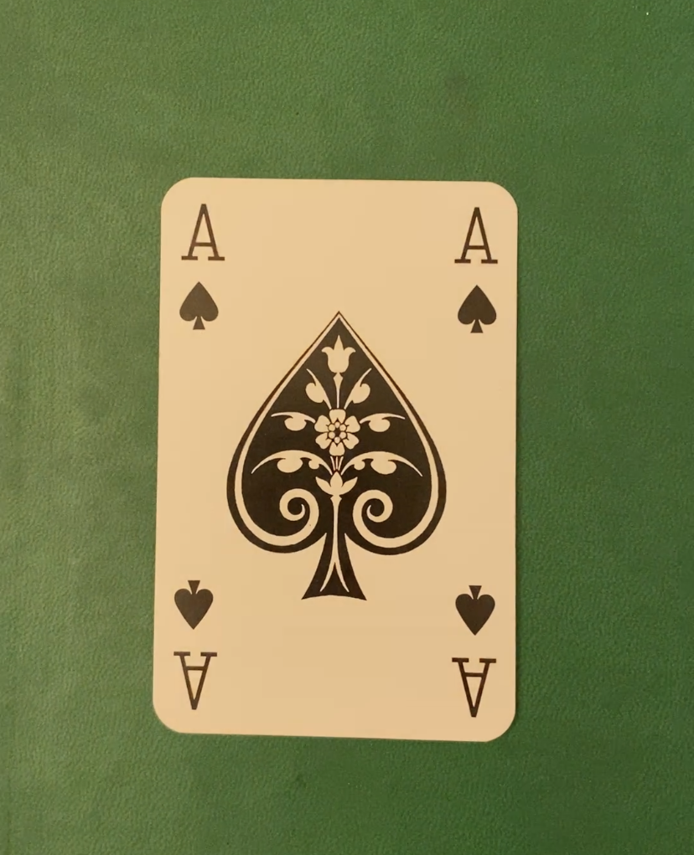
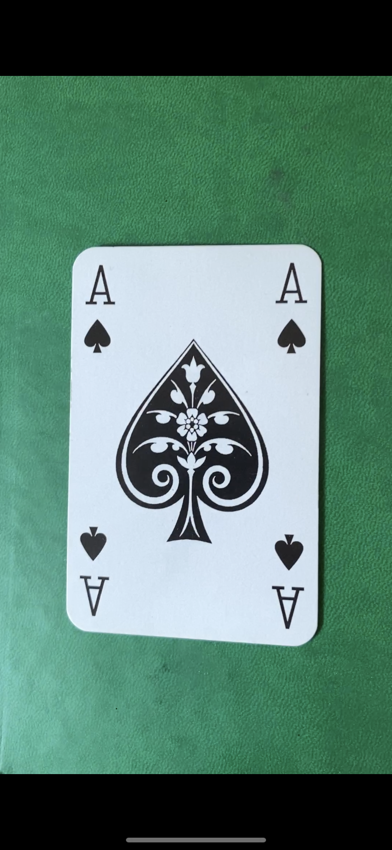
Card Detection
Dataset Preparation
Video for each card under different illumination levels
Extracting frames for each card from 52 different videos.
Balancing the dataset

Slide 4
Card Detection
Data Augmentation
Geometrical transformations, i.e. random rotation, random translation
Generating augmented images with two and three cards
1/10 validation set training set ratio
100000 images in training 10000 images in validation set

Slide 5
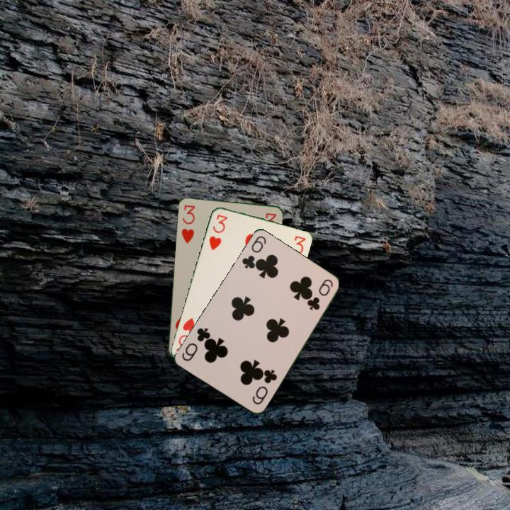
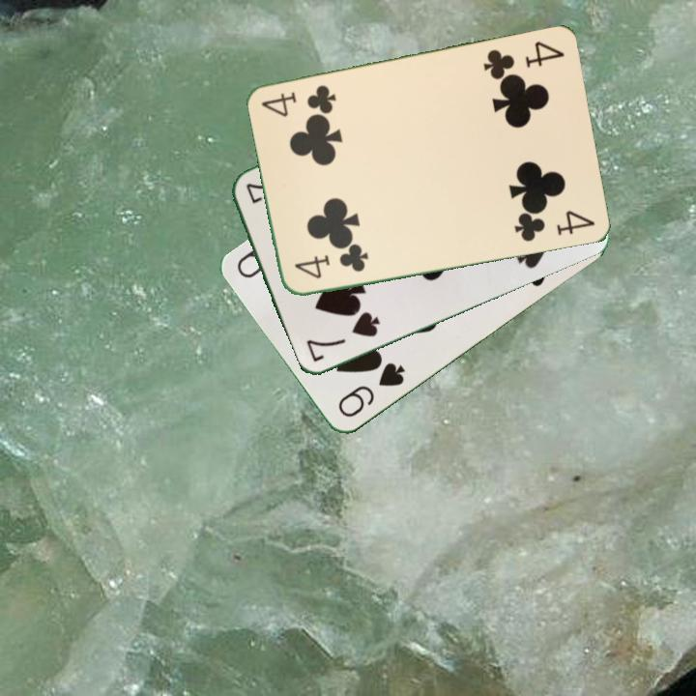
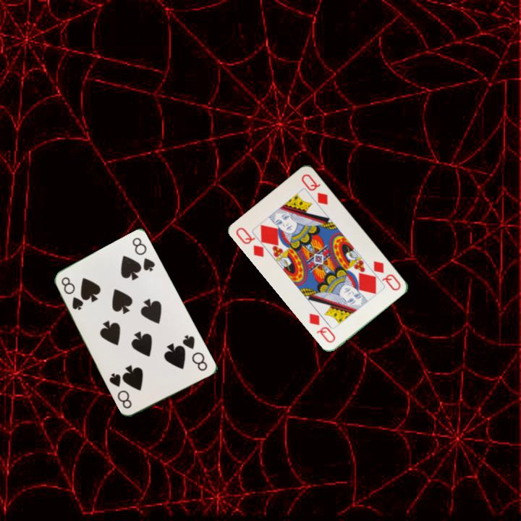
Card Detection
Training
Trained on GTX1080 8GB for ~8 hours
Pretrained on MS COCO
Used YoloV4 with input size 608x608
Implemented on Darknet Framework

Slide 6
Card Detection
Strategy:
Crop main image into 6 regions, i.e. P1, P2, P3, P4, left T, right T
Run YOLO for each image
Order cards with respect to their positions.
Fuse detected card names into dictionary

Slide 7
Card Detection
Results:
Training Set Accuracy: %96
Inference time per image: ~ 20s

Slide 8
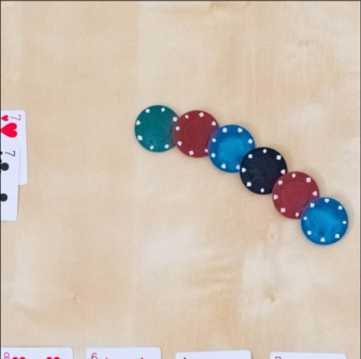
Chip Detection
The goal is to count the number of chips with the same color.
No machine learning used.
A combination of Image Analysis methods seen during the semester, namely:
Color thresholding
Noise filtering
Opening and Closing

Slide 9
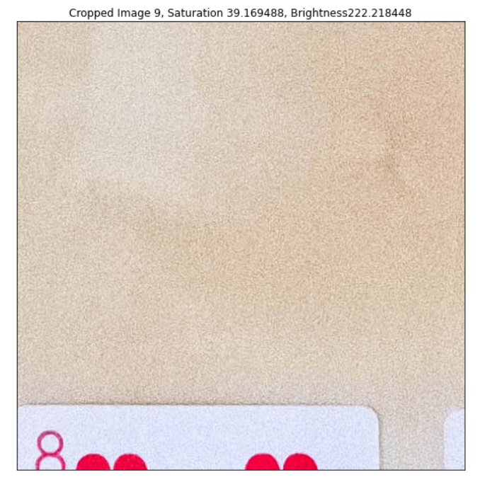
Chip detection - Separation between standard and underexposed images
Cropping the image to only keep the zone with the chips.
Analysing the HSV values of the lower left corner to find underexposed ones.

Slide 10
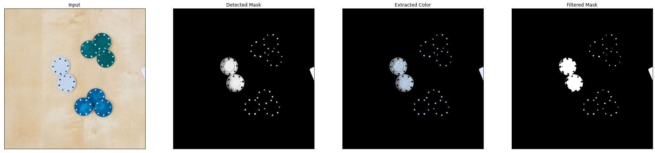
Chip detection - Color thresholding
Applying the correct set of HSV masking depending on the exposure of the picture.
Filtering the resulting mask to remove some noise (Also has the advantage of making some chips more homogeneously defined).

Slide 11
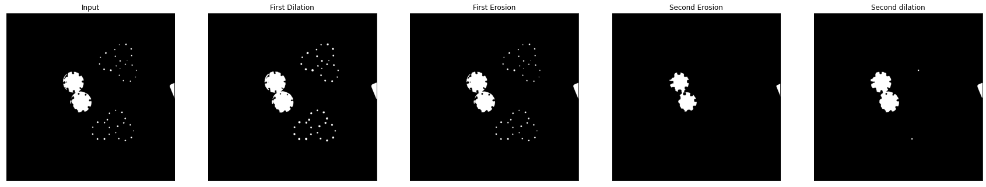
Chip detection - Opening and closing
Opening and closing to remove more small objects and fill in some holes.

Slide 12
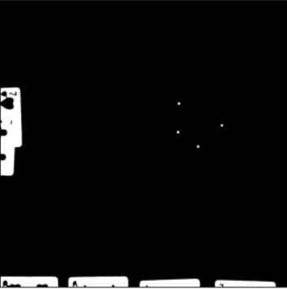
Chip detection - Leftover objects removal
Removal of leftover objects of size smaller than half that of a chip, as well as objects on the edge of the pictures (in case cropping left some cards in.

Slide 13
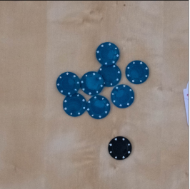
Chip detection - Counting chips
Sum of the ratios of the areas of the remaining objects over that of a single chip (rounded up).
Method is serviceable but lacks robustness. Could still be improved.

Slide 14
Chip detection - Other problems with the method
Time consuming.
Not optimised for different setups (different table positions or chip sizes)

Slide 15
References
Training YOLO
https://github.com/AlexeyAB/darknet#pre-trained-models
Weights File:
https://drive.google.com/drive/folders/10Q4sC3_5R9in9GhbcQCFHOAOcJyUp1Tr?usp=sharing

